Slide 1
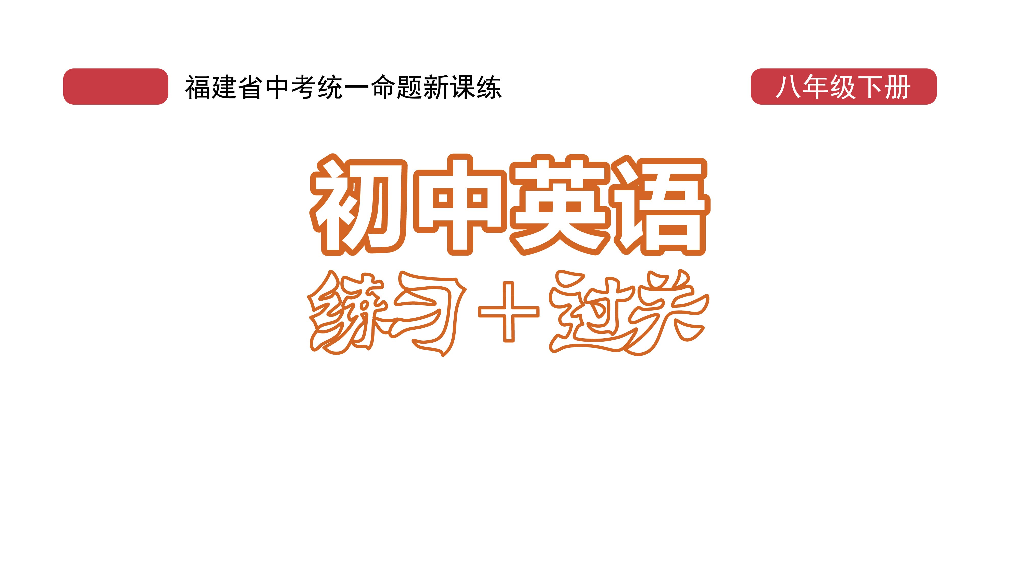
课时练习
模块八 第一章 读写综合训练

Slide 2
一、完形填空。
Clothing is a language. We can look at the traditional clothing to know more about 1 .
Africa has a long history and a rich culture, and this is 2 in traditional dress. The three colors—red, gold and 3 are often used in its clothing industry. The first color represents(代表) the blood(血) of millions
1. A. fashion B. culture C. spirit
2. A. chosen B. done C. shown
3. A. green B. blue C. purple
B
C
A

Slide 3
一、完形填空。
of people who fought 4 freedom（自由）; the second, rich resources of the African land; and the third, the grassland（草原） of home.
Because clothing has strong social meanings, people are very 5 in choosing what to wear. It would be a serious mistake to wear the wrong clothes, 6 to
4. A. against B. for C. with
5. A. careful B. helpful C. active
6. A. and B. but C. or
B
A
C

Slide 4
一、完形填空。
dress in the wrong way. For example, in Ghana, a woman should wear her waistband 7 according to(根据) the importance of the social event.
Traditional dress also tells us about everyday life. Africans usually wear loose(宽松的) clothing. The temperature there can be very 8 during the
7. A. successfully B. differently C. regularly
8. A. high B. low C. normal
B
A

Slide 5
一、完形填空。
daytime but very low at night, so the clothes need to be 9 for daily life.
Today although more and more young people, especially those in big cities, like wearing western clothes， traditional African dress is 10 quite important with its deep cultural meanings.
9. A. fancy B. pretty C. comfortable
10. A. even B. then C. still
C
C

Slide 6
二、阅读理解。
This 13-year-old baker(面包师) doesn’t just serve up delicious treats to paying customers—he also serves them up to the homeless and hungry people in Washington DC.
Since Michael Platt has always loved to bake, he decided to use his interest as a way to help the poor, so when he was 11 years old, he started a baking business called Michael’s Desserts.

Slide 7
二、阅读理解。
The bakery runs on a one-for-one business model similar to Tom’s Shoes: for every cake that a customer buys, Michael gives one away to a poor person.
Once or twice every month, Michael travels from his home in Bowie, Maryland to Washington DC so he can hand out baked treats to kids, adults and families in poor areas and homeless shelters. The teen volunteer(志愿者) also works with volunteer groups in Washington DC to share his baked treats.

Slide 8
二、阅读理解。
“I always have a dream for what I do,” Michael said. “It’s all about helping people—not just having a dream for yourself, and this is the meaning of life.”
Michael says he mostly fills treat orders for people in the DC area, but he has sold his treats to other states as well. If you want to check out some of Michael’s creations or make an order, you can visit his website.

Slide 9
二、阅读理解。
( )1. Where does the 13-year-old baker come from?
A. China. B. Japan.
C. England. D. America.
D

Slide 10
二、阅读理解。
( )2. If Michael sells 50 cakes, how many cakes does he give away?
A. 25 cakes. B. 50 cakes.
C. 75 cakes. D. 100 cakes.
B

Slide 11
二、阅读理解。
( )3. Where does Michael hand out baked treats?
A. In Bowie. B. On his website.
C. In Washington DC. D. In his bakery.
C

Slide 12
二、阅读理解。
( )4. Michael may agree that the meaning of life is to _____.
A. make more money B. care for himself
C. bake more treats D. help people
D

Slide 13
二、阅读理解。
( )5. We can learn from the last paragraph that _____.
A. we can order treats from Michael’s website
B. we can watch how Michael bakes treats
C. we can visit Michael if we have time
D. we can buy Michael’s treats everywhere
A

Slide 14
三、短文填空。
Hanfu fashion has become more and more popular 1 _ young people. China has followed western fashion 2 (design) in recent(近来的) years, but a growing number of young people are now looking to the past for fashion ideas.
with/among
designs

Slide 15
三、短文填空。
If you look closely around your city, you might 3 /ˈnəʊtɪs/ hanfu, the traditional clothing of the Han Dynasty. In a recent report(报道) by 4_____ online shopping platform(平台), about 2 million hanfu clothes were sold in 2019, about 4 times as many as those sold in 2018. Most of the buyers are between 19 5 24 years old.
notice
an
and

Slide 16
三、短文填空。
But why are many young Chinese people taking a liking for hanfu? For some of them, it’s a costume for relaxation. Dafan, a 24-year-old college student, told CGTN that 6 (dress) in hanfu is a way for her to get away from the trouble in real life. Modern clothing, on the other hand, represents the identity(代表身份) people need to show every day. “Hanfu and modern clothing help me to show the different sides in me,” she said 7 (happy).
dressing
happily

Slide 17
三、短文填空。
Other teenagers like hanfu because of the culture 8 /bɪˈhaɪnd/ it. They regard it as a way to reconnect with traditions(重拾传统). Its 9________ /ˈspeʃl/ design brings people back to ancient times.
“Hanfu is a symbol of the traditional Chinese culture,” Nanhe, a 21-year-old costume store 10 (own), told CGTN.
behind
special
owner

Slide 18
四、书面表达。
假如你是李虹， 请你根据以下思维导图的提示， 用英语写一篇不少于80词的短文， 介绍一下你和几位好朋友喜欢的衣服并说明理由。（开头已给出， 不计入总词数）

Slide 19
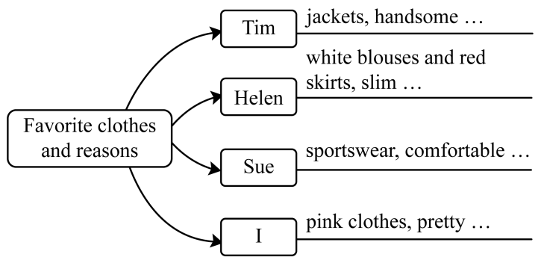
四、书面表达。

Slide 20
四、书面表达。
Tim, Helen and Sue. They like wearing different kinds of clothes. Tim likes wearing jackets. He thinks they make him look handsome and confident. Helen enjoys wearing white blouses and red skirts because she thinks that she looks slim and beautiful in them. Sue is fond of sportswear because she likes doing sports and she
I have three good friends. They are

Slide 21
四、书面表达。
feels comfortable when she wears it. As for me, pink clothes are my favorite because I like pink best. My friends say that I look pretty in pink.

Slide 22
